Slide 1

Github
By Kham Pok and Kiyunna Flourius

Slide 2
About the Company
Founded: February 8, 2008
  Thomas “Tom” Preston-Werner
  Chris Wanstrath (CEO)
  PJ Hyett (COO)
  Headquarters
    San Francisco, California
  First Commit
    October 2007
  Launched
    April 10, 2008
  69+ million projects hosted
  About 25 million users
Notes:
https://www.forbes.com/cloud100/list/#header:funding_sortreverse:true

Slide 3
What is Github?
Git is an open – source version control system developed in 2005 by Linus Torvalds, the creator of Linux operating system kernel
  Version control: Keeps track of every modification to the code in a special database. This allows developers to compare earlier versions and make changes to the code, while minimizing disruption to the team members
Github is an open –source code hosting site. It is a cloud service that allows users to store, modify, and share source code repositories with other developers.
Front End: HTML, CSS, JavaScript
Back End: Ruby, SQL (MySQL)
https://github.com/collections/projects-that-power-github
Notes:
https://www.howtogeek.com/180167/htg-explains-what-is-github-and-what-do-geeks-use-it-for/
https://www.thebalance.com/what-is-github-and-why-should-i-use-it-2071946
https://www.youtube.com/watch?v=uUuTYDg9XoI

Slide 4
Github Features
Fork
  Also known as a branch
  A repository that has been copied from one member’s account to another member’s account
  Allows developer to make modifications without affecting the original code
Pull Request
  Allows developer to share modifications to the owner of the original repository
Merge
  Allows the owner of the original repository to merge the developers modifications into the repository
Github Gist allows GitHub users to share pieces of code or other notes.
GitHub Flow is a lightweight, branch-based workflow for regularly updated deployments.
GitHub Pages are static webpages to host a project, pulling information directly from an individual's or organization's GitHub repository.
GitHub Desktop enables users to access GitHub from Windows or Mac desktops, rather than going to GitHub's website.
GitHub Student Developer Pack is a free offering of developer tools that is limited to students, and includes cloud resources, programming tools and support, and GitHub access.
Notes:
http://searchitoperations.techtarget.com/definition/GitHub

Slide 5
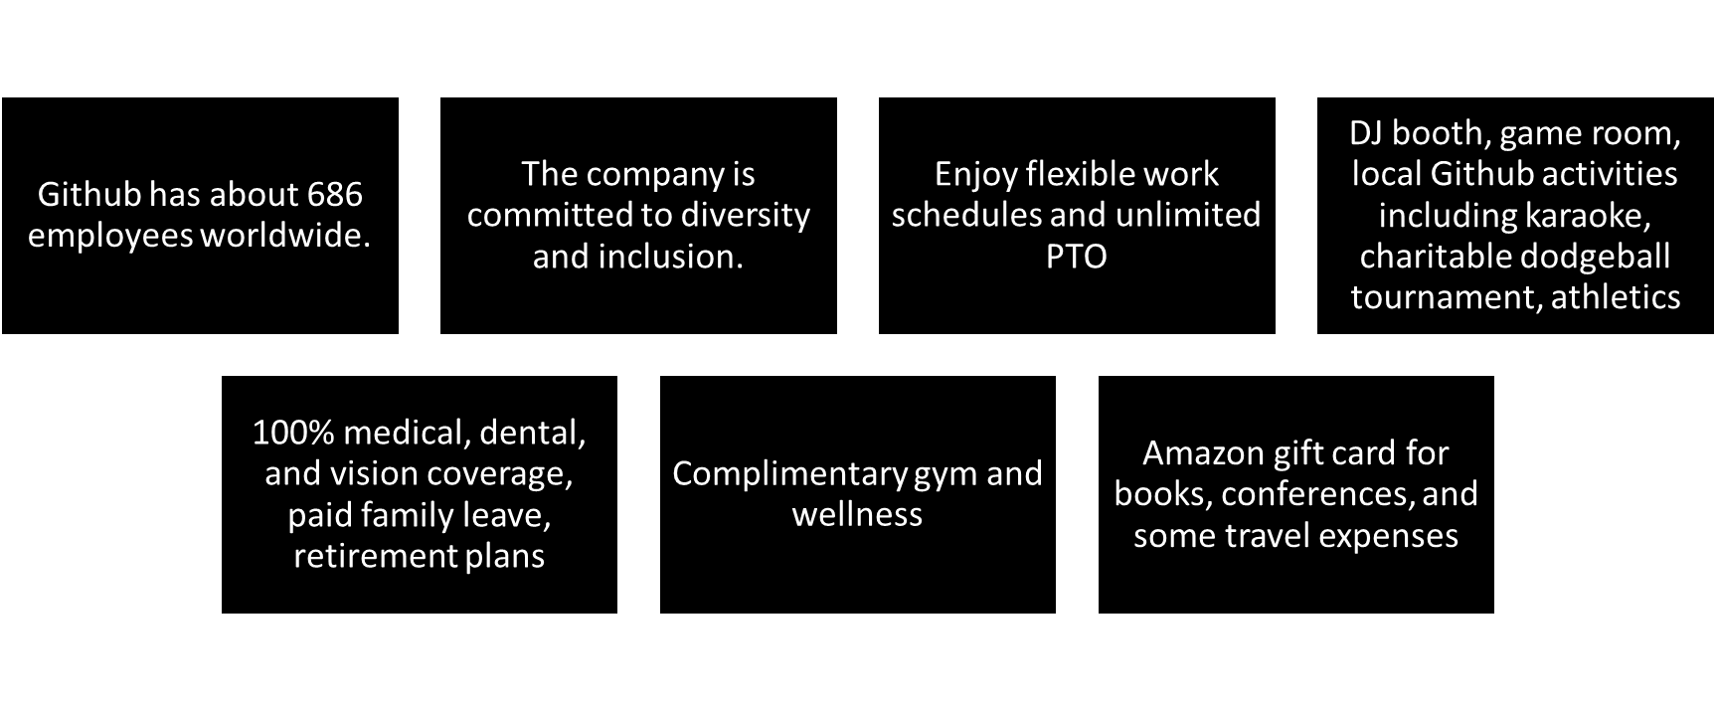
Working at Github: The Perks

Slide 6
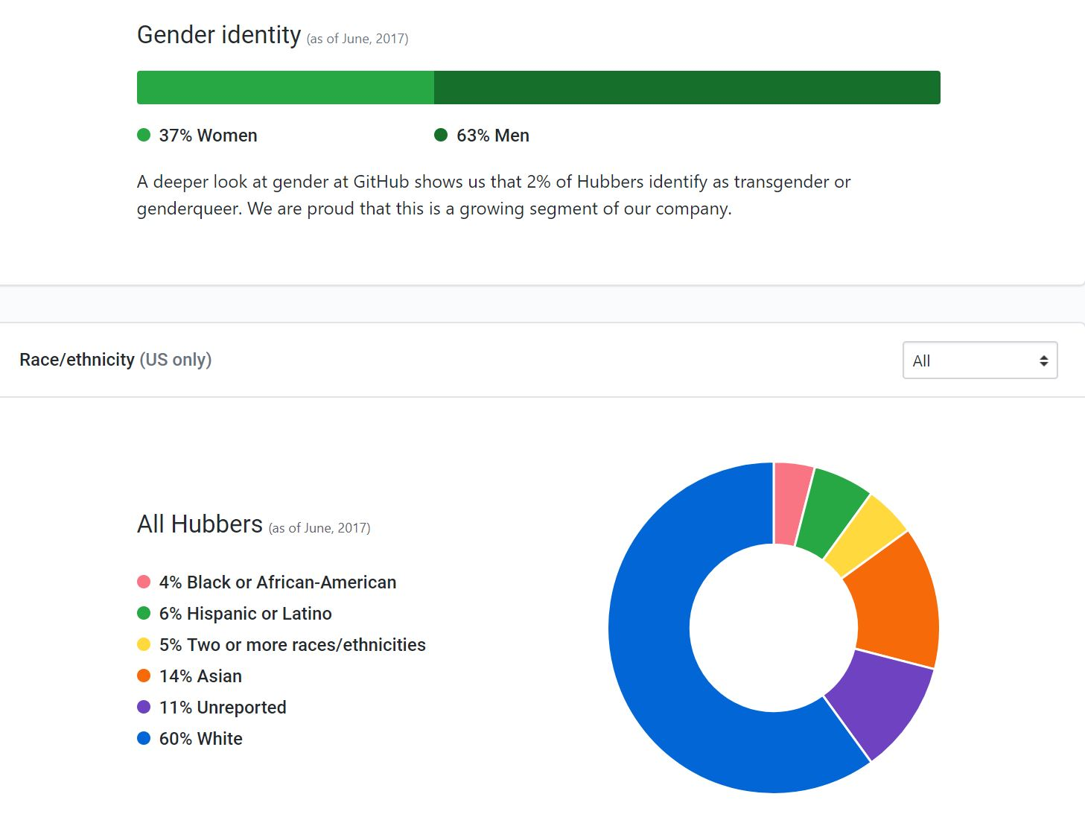
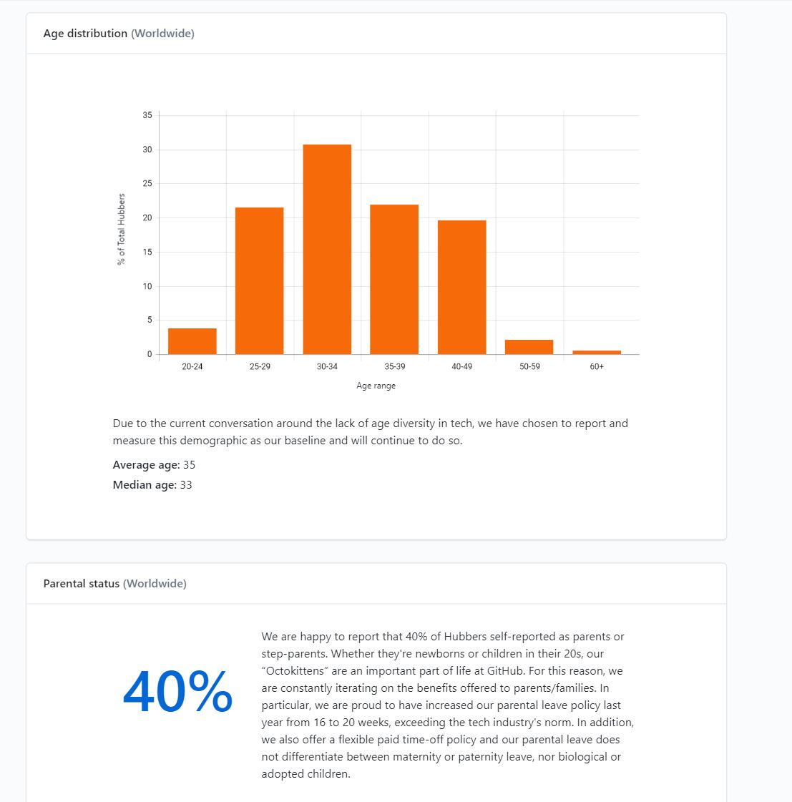
Employee Demographics
Notes:
https://diversity.github.com/

Slide 7
Working at Github
Developer $126K
  Skills: Git, Ruby on Rails, Ruby, JavaScript, Agile Methodologies
  Software Engineer $145K
    Skills: MySQL, JavaScript, HTML, Web Applications, CSS
    Application Engineer $129K
      Skills: JavaScript, Git, HTML, Python, Ruby on Rails
      Solutions Architect $131K
        Skills: Git, Product Strategy, SAN, Management, Collaboration
        Enterprise Architect $164K
          Skills: SaaS, JavaScript, Leadership, Management, Strategy
          Senior Software Engineer $194K
            Skills: Web Development, CSS, JavaScript, Software Development, Web Applications
            https://www.youtube.com/watch?v=-RhhP7kv57g
Notes:
https://www.paysa.com/salaries/github

Slide 8
Getting a Job at Github
The Process
The process can take anywhere from 4 weeks – 2 months.
Take home project
A culture fit screen with two engineers from the team over Zoom
Full day of Interviews
  Engineering practices
  Technical interview
  Social outlook
  Hiring manager
https://boards.greenhouse.io/github/jobs/858389#.WeUFH2iPLic
Examples of Interview Questions
A lot of “Describe a time when…” questions
How would you explain a database to a 10 year old? SQL questions
Coding challenge: build a simplified version of battleship
As a young white male, how do you feel you can contribute to GitHub's diversity goals?
Re-implement a (specific) feature of git in a language of your choice.
Notes:
https://boards.greenhouse.io/github/jobs/858389#.WeUFH2iPLic
https://www.glassdoor.com/Interview/GitHub-Interview-Questions-E671945_P4.htm

Slide 9

Similar Company: GitFile
Gain CS & Business experience
  Education, degree, or work experience
Generate ideas for the company
  Research, determine audience & market
Obtain patents and trademarks
Create Business Plan
  Determine legal structure of company – partnership
  Register DBA name
  Hire accountant and attorney for licensing, taxes, and insurance
  Raise money
    Grants, Loans, Investors, Online funding services
  Purchase computers, software, data storage capability, servers, etc
  Hire developers to create, test, and maintain the product
  Market Product
    Friends, family, social media, newspapers, marketing professionals
Notes:
https://www.wikihow.com/Start-a-Software-Company

Slide 10

Interview
What is a ‘conflict’ in git?
  A ‘conflict’ arises when the commit that has to be merged has some change in one place, and the current commit also has a change at the same place. Git will not be able to predict which change should take precedence.
Notes:
https://career.guru99.com/top-40-interview-questions-on-git/

